Slide 1
What is a microbiome?
Why are microbes important for their hosts?

Slide 2
Question: Are there sex differences in the bean beetle microbiome?
H₀: There are no differences between the sexes.
H₁: There are differences between the sexes.
Notes:
(note, as a class, we had come up with this question beforehand as a possible experimental focus)
In the bean beetle microbiome experiment, you might come up with a question something like this.

Slide 3
Question: Are there sex differences in the bean beetle microbiome?
H₀: There are no differences between the sexes.
H₁: There are differences between the sexes.
Notes:
There are several important words buried in this question that need to be defined. The first is microbiome. This is a word that has been mentioned more and more in the press, but what does it really mean?

Slide 4
Question: Are there sex differences in the bean beetle microbiome?
H₀: There are no differences between the sexes.
H₁: There are differences between the sexes.
Notes:
The second word that needs to be defined is “differences.” In the above question, we are implying that we are going to measuring something in samples of males and females and determine if that something is statistically significantly different. What are we going to measure?

Slide 5


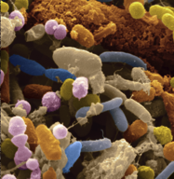
Microbes that cause disease.
Other host-associated microbes.
Notes:
First, let’s consider “microbiome.”
Since the discovery the microorganisms cause disease, we have studied and tried to treat many of these infectious diseases. But, for almost as long as we have known the microbes cause disease, we have known that most animals and plants are associated with a lot of different microbes. In humans, these microbes include diverse communities of bacteria, archaea, viruses and fungi. Because of the diversity of these microbes, and because we can’t easily grow most of then outside of their hosts, we largely ignored them. We focused our scientific efforts on those that caused disease.

Slide 6

Microbes that cause disease.
Other host-associated microbes.
Notes:
But, the fact is that most plants and animals, including humans, have been associated with these microbial communities for millions of years. They too shape the health, ecology and evolution of their hosts. As technologies have advanced, we have gotten a better idea of what these communities are and why they are important.

Slide 7
Microbiome
All of the microbes, their genomes, and their interactions within a defined environment
Includes bacteria, archaea, fungi, and viruses.
Notes:
We can define the microbiome of a host or environment as:
All of the microbes, including bacteria, archaea, fungi, and viruses, their genomes, and their interactions within a defined environment Includes bacteria, archaea, fungi, and viruses.
We can define the microbiota of a host or environment as:
All of the microbes, including bacteria, archaea, fungi, and viruses
Note, the former includes the genes of those microbes and their function, while the latter is more about the membership of the community regardless of function.
Also note, for this project, we will only be sequencing bacteria, so when we say microbiota or microbiome, we mean all the bacteria and not all the other microbes.

Slide 8

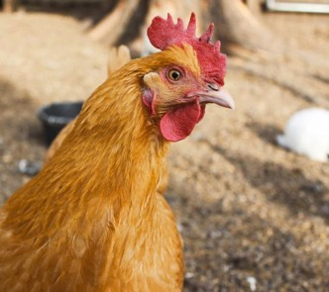
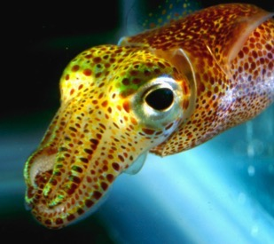
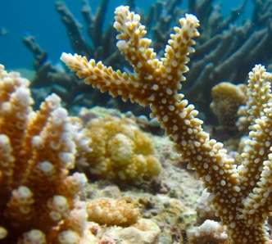
Notes:
Not only humans have microbiomes. Many organisms, from chickens to the crops we grow, are associated with a complex community of microbes.
References:
Ley, R. E., Hamady, M., Lozupone, C., Turnbaugh, P. J., Ramey, R. R., Bircher, J. S., et al. (2008). Evolution of Mammals and Their Gut Microbes. Science (80-. ). 320, 1647–1651. doi:10.1126/science.1155725.
McFall-Ngai, M., Hadfield, M. G., Bosch, T. C. G., Carey, H. V, Domazet-Lošo, T., Douglas, A. E., et al. (2013). Animals in a bacterial world, a new imperative for the life sciences. Proc. Natl. Acad. Sci. U. S. A. 110, 3229–3236. doi:10.1073/pnas.1218525110/-/DCSupplemental.
Weiss, B., and Aksoy, S. (2011). Microbiome influences on insect host vector competence. Trends Parasitol. 27, 514–522. doi:10.1016/j.pt.2011.05.001.
Christian, N., Whitaker, B. K., and Clay, K. (2015). Microbiomes: unifying animal and plant systems through the lens of community ecology theory. Front. Microbiol. 6, 1–15. doi:10.3389/fmicb.2015.00869.

Slide 9
Increasing Research on the ‘Microbiome’
Notes:
One reason we know so much more about this today than before is of new abilities to sequence the DNA of microbes in order to identify what they are. This has led to a revolution in the study of microbial communities and their functions.

Slide 10
The human microbiome

Slide 11
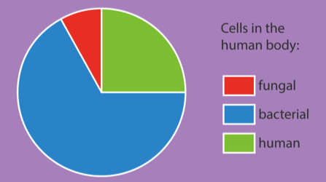
10,000,000,000,000
Bacterial cells
In a single human body:
About 1 microbe cells for about every 1 human cell
About 500,000 microbe genes for about every 25,000 human genes
ASM
Qin et al. 2010. Nature; Sender et al. 2016. PloS Biology
Notes:
In humans, there are a lot of microbes. The average human body contains about 10¹³ bacterial cells and about the same number of human cells.
More importantly, they are way more microbial genes a human body than human genes, suggesting that the human microbiome can do a lot of things.
References:
Qin, J., Li, R., Raes, J., Arumugam, M., Burgdorf, K. S., Manichanh, C., et al. (2010). A human gut microbial gene catalogue established by metagenomic sequencing. Nature 464, 59–65. doi:10.1038/nature08821.
Sender, R., Fuchs, S., and Milo, R. (2016). Revised estimates for the number of human and bacteria cells in the body. PLoS Biol. 14, 1–14. doi:10.1371/journal.pbio.1002533.

Slide 12

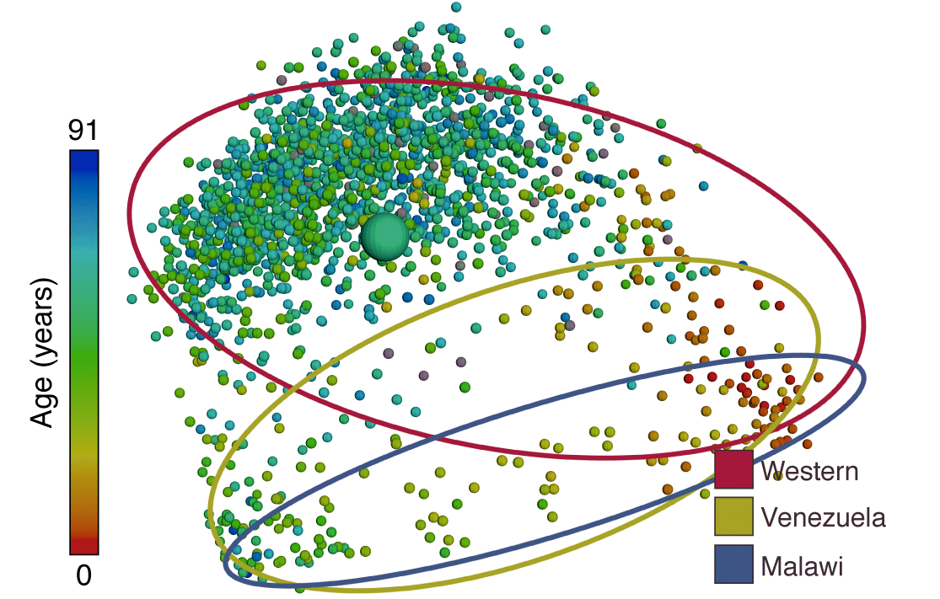
Every human is associated with a unique set of bacteria.
Notes:
While we don’t know what a lot of the bacterial species in your body are doing, we do know that each human is associated with a unique set of bacteria.
Here, we see a plot from the American Gut project. For this project, volunteers send a fecal sample from which their bacterial microbiota of their gut is characterized. Here, two points on the graph that are close together indicate two volunteers that have similar gut microbiota. Two points that are farther apart represent volunteers whose gut microbiomes are more different. Overall, individuals of similar ages tend to have more similar gut microbes. We can see this by the fact that most infants (the red dots) are on the right, while most senior citizens (blue dots) are on the left.
We can also see an impact of where you live. Here, there are data from people living in the west (mainly the United States), in Venezuela and in Malawi. The ovals show where individuals from each of those regions are on the graph. The ovals don’t completely overlap, particularly as people get older. This may in part be driven by differences in diet between the three regions.
References:
McDonald, D., Hyde, E., Debelius, J. W., Morton, J. T., Gonzalez, A., Ackermann, G., et al. (2018). American Gut: an Open Platform for Citizen Science Microbiome Research. mSystems 3, 1–28. doi:10.1128/mSystems.00031-18.
http://humanfoodproject.com/americangut/

Slide 13
Each part of your body is associated with a unique set of bacteria.
Koren et al . 2013. PLoS Computational Biology
Notes:
Each part of your body is also associated with a unique set of bacteria.
References:
Koren, O., Knights, D., Gonzalez, A., Waldron, L., Segata, N., Knight, R., et al. (2013). A guide to enterotypes across the human body: meta-analysis of microbial community structures in human microbiome datasets. PLoS Comput. Biol. 9. doi:10.1371/journal.pcbi.1002863.
Turnbaugh, P. J., Ley, R. E., Hamady, M., Fraser-Liggett, C. M., Knight, R., and Gordon, J. I. (2007). The Human Microbiome Project. Nature 449, 804–810. doi:10.1038/nature06244.
The Human Microbiome Consortium (2012). Structure, function and diversity of the healthy human microbiome. Nature 486, 207–214. doi:10.1038/nature11234.

Slide 14
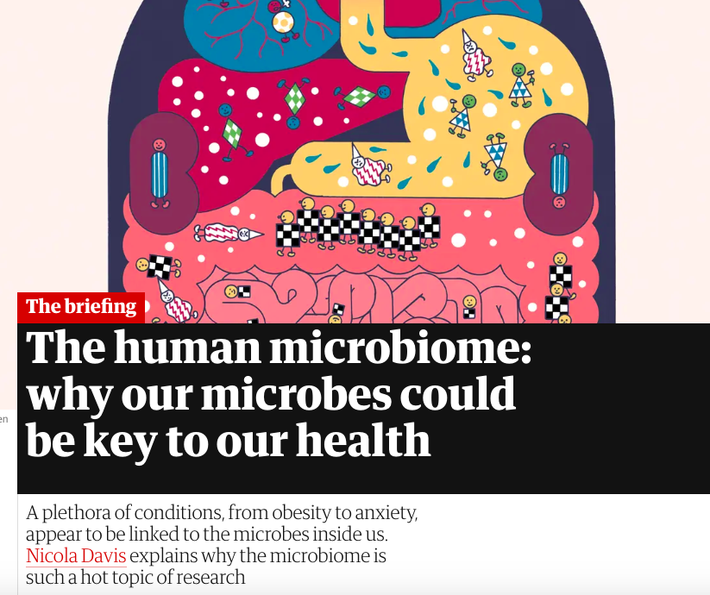
The Guardian
Notes:
For humans, this revolution has come with unprecedented interest in the roles that microbes may play in shaping our health and in how we interact with the environment. It has changed our willingness to take antibiotics without clear evidence of a harmful bacterial infection. It has shape research into many diseases, from obesity to anxiety.

Slide 15
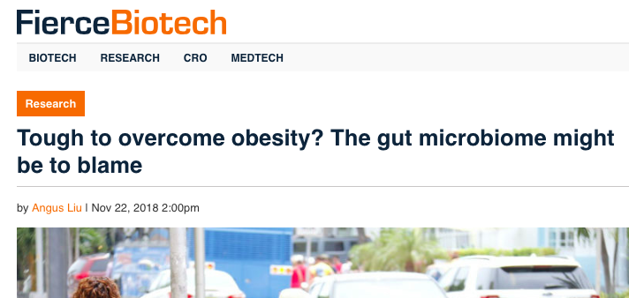

Slide 16
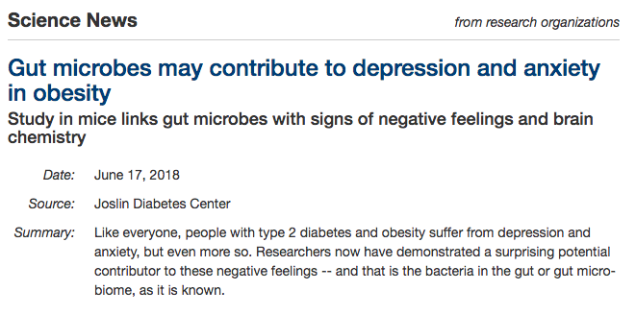

Slide 17
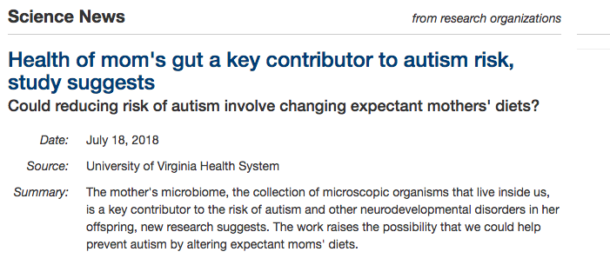

Slide 18
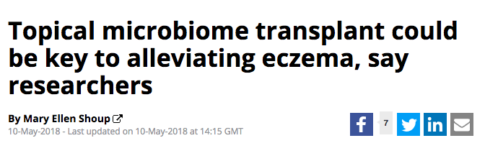

Slide 19
Notes:
Overall, there are many, many studies, some of which are high quality science and show a clear causal relationship between a microbe or microbes and diseases. In other cases, the research is only in its infancy and it likely not at the stage where it should shape practice. Despite this, more an more companies are exploiting interest in the microbiome to cell products, like these probiotics that cause $50 a bottle.

Slide 20
Insect Microbiomes

Slide 21
Data from World Health Organization
Notes:
Insects are important for a number of reasons. They pollinate our plants. They are food for many animals. The transmit disease. In fact, mosquitoes are considered the most deadly animals on earth because they transmit diseases to humans.

Slide 22
Wolbachia bacteria inside insect cell
Notes:
Because of their importance, we have studied many aspects of insect biology, including their association with bacteria, for centuries.
Many insect systems also serve as models for studying animal-microbe interactions more generally because insects tend to have simpler microbially communities inside of them than vertebrates, including humans.
Here is an image of one of the best-studied and most common insect-associated bacteria. The circles are Wolbachia bacteria that live inside insect cells. It has been estimated that more than 60% species of insects are associated with Wolbachia.

Slide 23
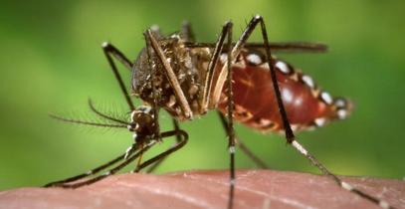
Notes:
The bacteria have been used to try and lessen the ability of mosquitoes to vector diseases. The first work involved introducing Wolbachia into mosquitoes that shortened their life long enough that they could pass on the bacteria to their children but short enough that viruses like dengue did not have enough time to develop.

Slide 24
Notes:
This shortened the mosquitoes lives because it lessened the ability of mosquitoes to feed.

Slide 25
Notes:
Then, it was found that other Wolbachia did something else. The made it harder to viruses like those that cause dengue and malaria to replicate inside the mosquitoes.

Slide 26
Notes:
The Bill and Melinda Gates Foundation is paying researchers to release mosquitoes carrying these Wolbachia into communities.
References:
http://www.eliminatedengue.com/program

Slide 27
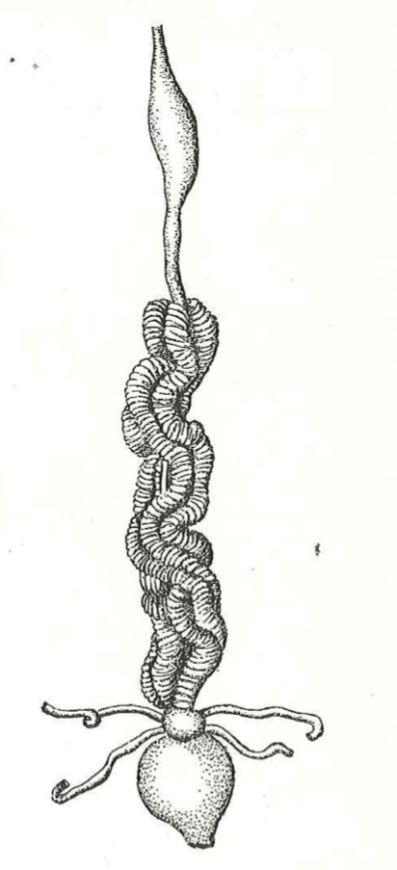
Endosymbiosis of animals with plant microorganisms. Buchner. 1965
Notes:
Many insects beyond mosquitoes have an association with one or a few bacteria that are particularly important for the development, ecology and evolution. Here, we see the drawing of a stinkbug digestive tract. Along the digestive tract. Along most of the digestive tract is a big organ folder up like an accordian.

Slide 28
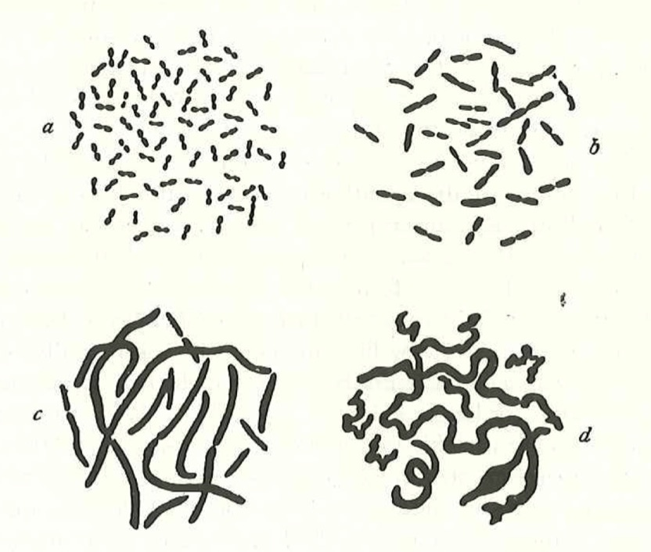
Endosymbiosis of animals with plant microorganisms. Buchner. 1965
Notes:
As early as the 1930s, researchers began to use microscope to look inside these type of organs. The often found one or a few types of microorganisms, which you see in drawings here. They could not sequence the DNA of these bacteria to figure out what they were, but they hypothesized that they must be important for digestion by the insects since they were stored along the gut.

Slide 29
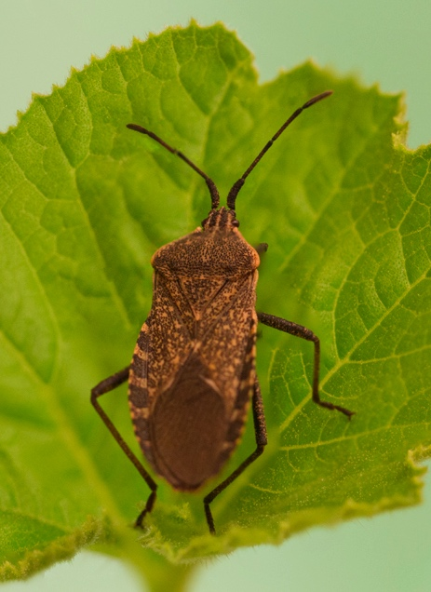
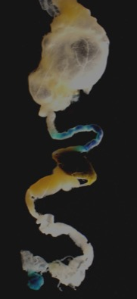
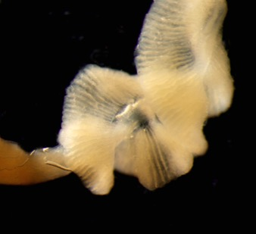
Notes:
This is an example of one of these insect. This is Anasa tristis, the squash bug. Squash bugs are important agricultural pests. Like in the drawing, they have a large section of their gut with lots of folds in it. They call these sections crypts

Slide 30



Types of Bacteria
Enterococcus
Lautropia
Unclassified
Wolbachia
Burkholderia
Earlier section of gut
relative abundance
Crypts
where
bacteria are
stored
relative abundance
Notes:
When researchers use sequencing technologies like being used as part of the bean beetle microbiome project, they find that the crypts mostly have bacteria in the genus Burkholderia, which are less common in other sections of the gut.

Slide 31
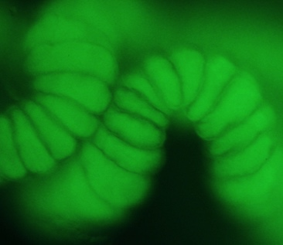
Crypt filled with GFP-labeled
Burkholderia
Notes:
These Burkholderia bacteria can be fluorescently labeled and fed back to the bugs. Here, you can see that the crypts are full of green fluorescent protein (GFP) labeled bacteria.

Slide 32
Burk +
Burk -
With Burkholderia
Notes:
Association with Burkholderia has a number of benefits for the bugs. Here, we see that it increases survival over time relative to bugs not given Burkholderia.
References:
N.M. Gerardo, unpublished.

Slide 33
Notes:
Some of the best studied insect microbiomes are those associated with bees.

Slide 34
Notes:
Interest in bee associated microbes is in part because of declining bee populations in the United States.

Slide 35
Raymann & Moran. 2018. Current Opinion in Insect Science
Notes:
As in humans, each part of the bee has a specialized bacterial community.

Slide 36
Raymann & Moran. 2018. Current Opinion in Insect Science
Notes:
These bacteria play a number of important roles in the health of bees.

Slide 37
Zheng et al. 2018. Honey bee as models for gut microbiota research. Lab Animal.
Notes:
And, there are a lot of similarities between the impacts of microbes on bee physiology and the impacts of microbes on animal physiology, making them a model organism to study host-microbe interactions.
References
Zheng, H., Steele, M. I., Leonard, S. P., Motta, E. V. S., and Moran, N. A. (2018). Honey bees as models for gut microbiota research. Lab Anim. (NY). 47, 317–325. doi:10.1038/s41684-018-0173-x.
Raymann, K., and Moran, N. A. (2018). The role of the gut microbiome in health and disease of adult honey bee workers. Curr. Opin. Insect Sci. 26, 97–104. doi:10.1016/j.cois.2018.02.012.
References

