Slide 1
Bean Beetles as a Model System Bean Beetle Microbiome Project 2019 Workshop

Slide 2
Resources for Faculty at www.beanbeetles.org
Bean Beetle Handbook
Tested Laboratory Protocols
Bibliography
Microbiome Protocols
Microbiome Databases

Slide 3
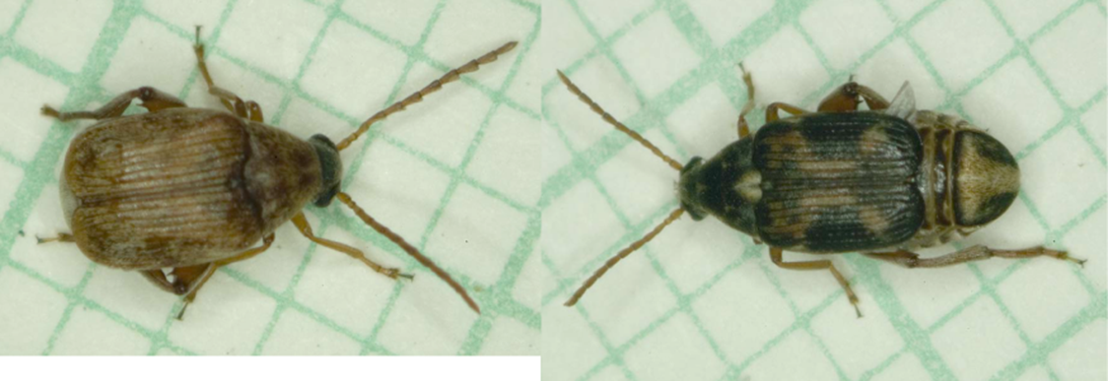
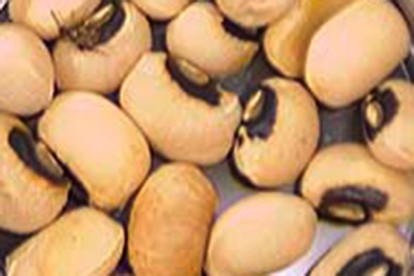
Bean Beetles Callosobruchus maculatus
Tropical species
Temperate zone invasion

Slide 4
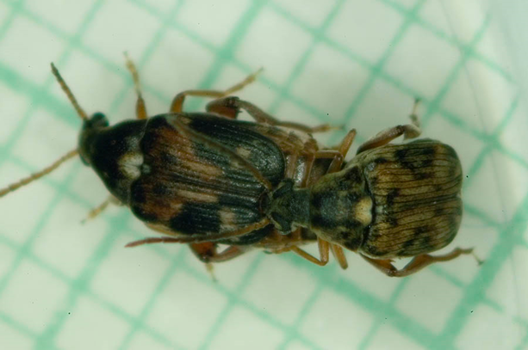
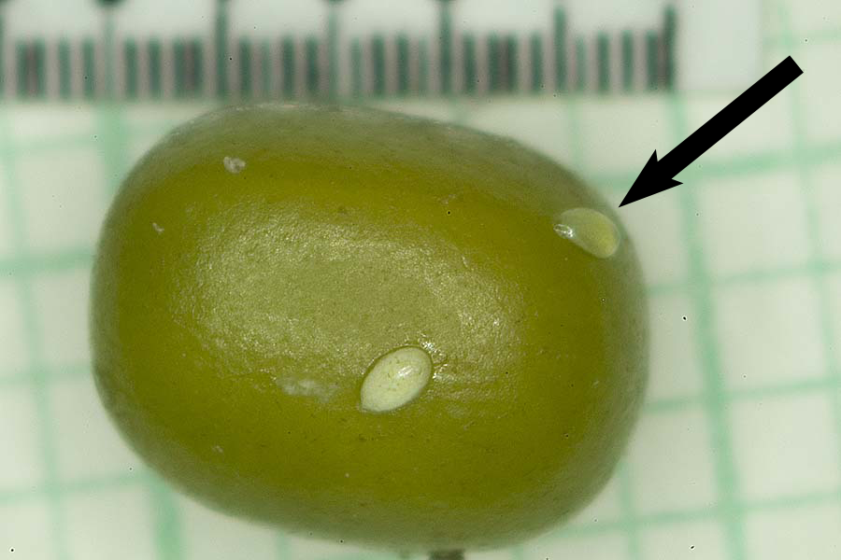
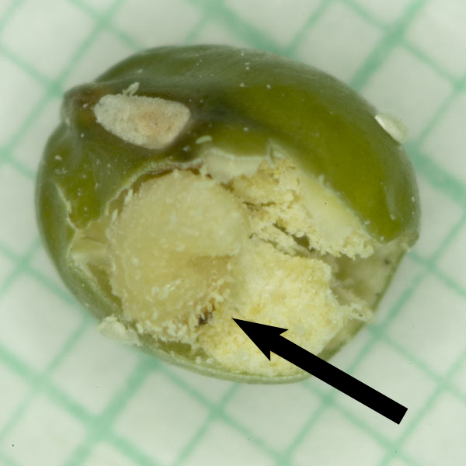
Bean Beetle Life Cycle

Slide 5
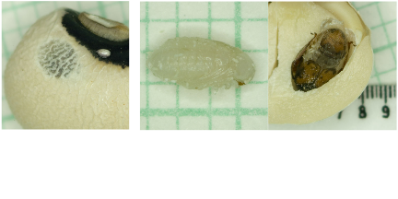
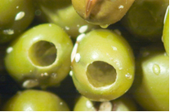
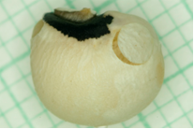

Slide 6
Bean beetles get all their nutrition from the host bean. Adult bean beetles do not feed.

Slide 7
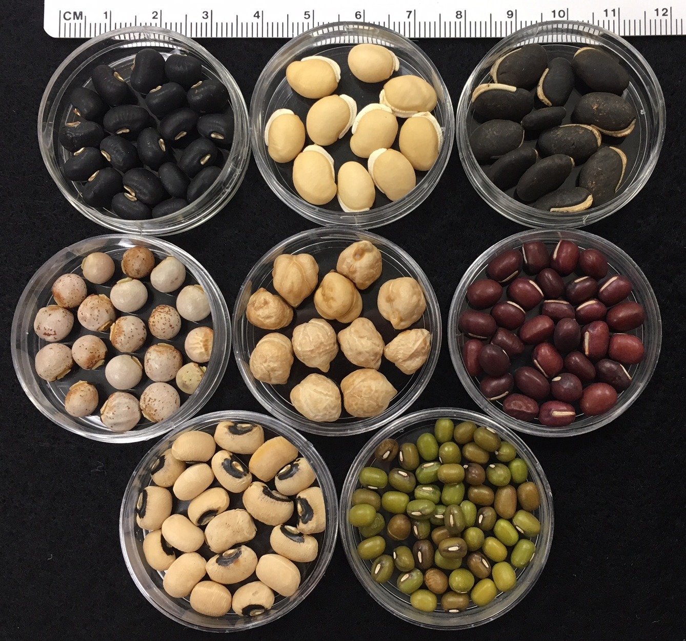
Dried beans: Blackeye peas Mung bean Adzuki bean Pigeon peas Hyacinth bean Chickpeas
Culture Methods

Slide 8
Life cycle (egg to adult emergence) time 3-5 weeks depending on host and temperature.

Slide 9
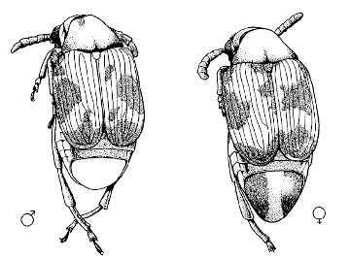
Sex Identification

Slide 10
Containment and Disposal
Bean beetles are agricultural pests
Do not release to environment
Do let let students take culture out of laboratory containment
Disposal
Freeze at -20°C for 72 hours (3 days)
double bag
dispose as food waste

